Slide 2
A special gospel meeting to build up disciples
October
21-24,
2018

Slide 3
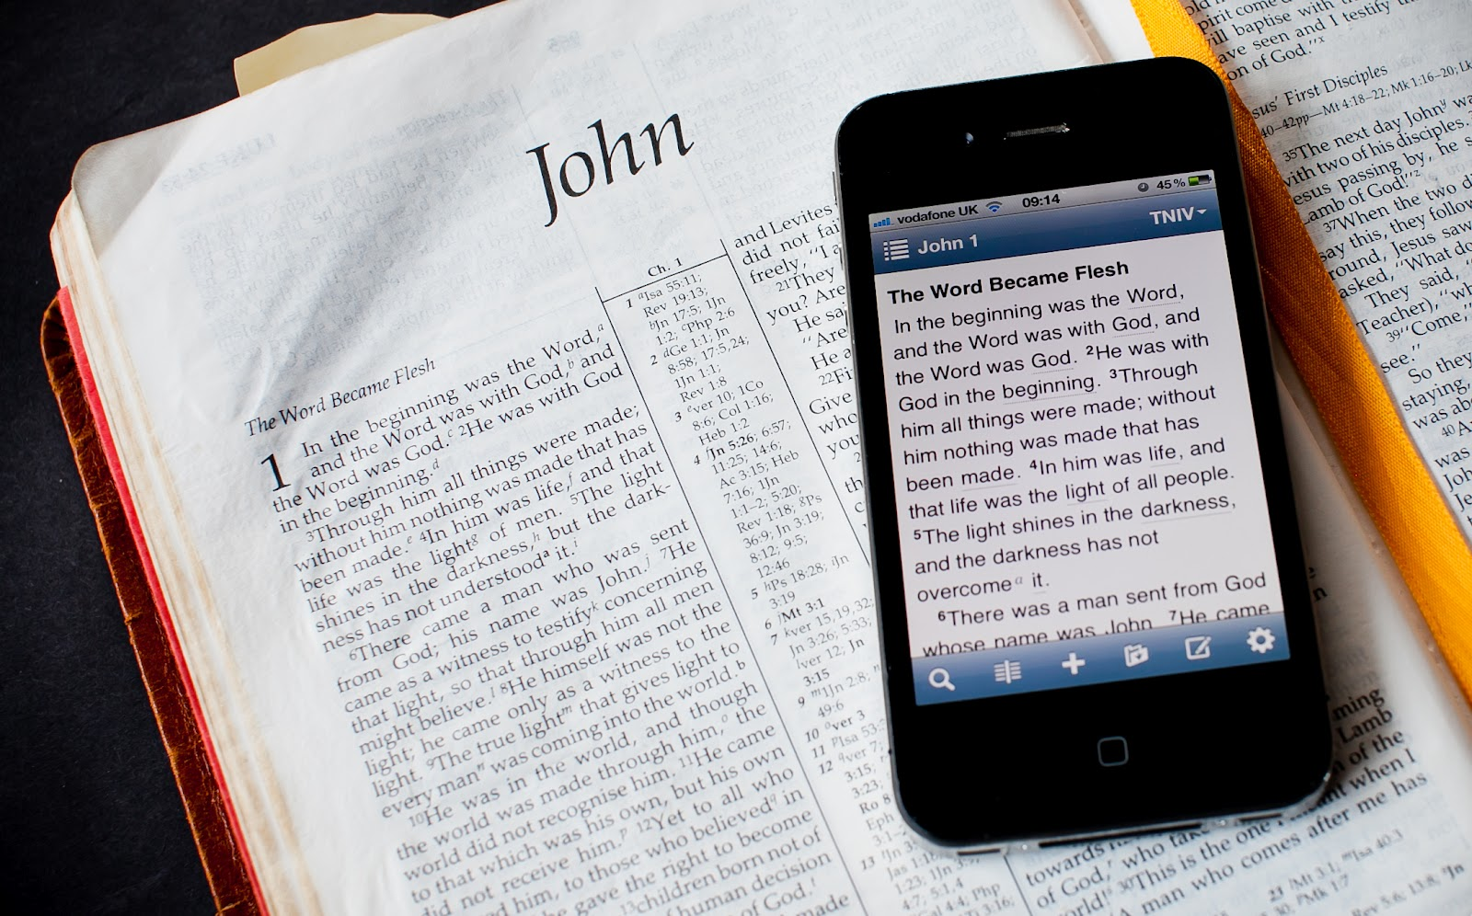
Workouts that Work: Daily Bible Reading

Slide 4
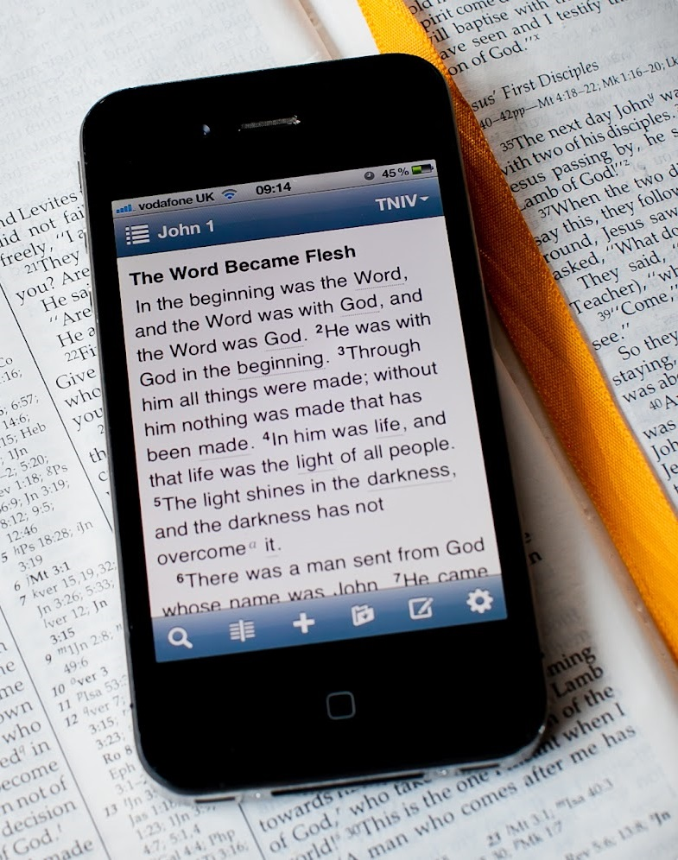
Key 1: Read on Purpose
To come to know God

Slide 5
Problem solved!
Don’t have time
Bible is hard to understand
Been there done that
I’ll just Google it
Eventually I will do this…

Slide 6
Key 1: Read on Purpose
To come to know God
Slow and steady progress

Slide 7
Key 2: Read it right

Slide 8
“Must Haves”
Quality Bible
Designated time to read
Prayer
A Bible reading plan

Slide 9
Key 2: Read it right
Consider the Word!

Slide 10
PATH the Chapter
Praise God
Admonishes me
Trust
Hope

Slide 11
Key 2: Do more than read
Consider the Word!

Slide 12
Key 3: Don’t Quit!

Slide 13
Workouts that Work: Daily Bible Reading

